Slide 1
A Christian path of reconciliation, dialogue, and hope.
Experience in Mexico, biblical reflection, and pastoral challenges.
Reflecting on the value of peace in life:
    Personal
    Community
    Spiritual
With attitudes of: Peace making
    Reconciliation
    Listening
    Transformation

Slide 2
Blessed are the peacemakers, for they will be called children of God.
What does peace mean to me?
How can I be a peacemaker today?
Peace is neither passivity nor indifference.
Christian peace is a spiritual, social, and communal task, and it involves:
      Reconciliation/healing
      Justice
      Listening
      Respect for human dignity
      Protection of life

Slide 3
Brief dinamic
The Sign of Peace
Walk around in silence
Then, when you meet someone, look at them in the eyes
Shake hands respectfully
And say:
Peace be with you
May God grant you peace

Slide 4
How we feel
It is easy to spread peace
What changes when we look at each other with respect
We are all seeking peace: with ourselves, with our neighbors, with the entire universe

Slide 5
Biblical passage Saint John 20:19-22
The passage in Saint John 20:19-22 is one of the great biblical teachings on Christian peace. It is not simply about the absence of conflict, but about the peace that comes from encountering the risen Christ and that transforms people into instruments of reconciliation.
"The Peace of the Risen Christ and Our Mission to Build Peace”

Slide 6
“Peace be with you. As the Father has sent me, so I send you.” And when he had said this, he breathed on them and said, “Receive the Holy Spirit.”
Context of the passage
The disciples are locked away in fear. They have witnessed the passion and death of Jesus, and now they experience uncertainty, sadness, and fear.
It is in this context that the Risen Christ appears.
It is important to note that Jesus does not begin with a reproach or a complaint for having abandoned him, but with a greeting full of mercy:
“Peace be with you.”
The first word of the Risen One to his disciples is PEACE.

Slide 7
Often our communities also live in isolation:
Because of fear. Because of conflict.
Because of past wounds. Because of family divisions.
Christ continues to enter into these realities to offer his peace.
What does peace mean according to Jesus?
The biblical word "Shalom" means much more than tranquility. It has to do with the wellbeing.
And it implies:
Fullness. Harmony with God. Reconciliation with others. Inner integrity. Abundant life.
The peace of Christ is not a fleeting emotion.
It is a gift that springs from victory over sin and death.

Slide 8
How does Jesus make peace?
Let's look at the actions of the Risen Lord.
1. He makes himself present.
Jesus enters where his disciples are.
Peace begins with presence.
Many times we want to resolve conflicts from afar, but Jesus teaches us to draw near.
We make peace when we:
Listen. Accompany. Visit.
Be present in the suffering of others.

Slide 9
2. He offers forgiveness rather than judgment.
The disciples had fled.
However, Jesus does not condemn them.
He offers them PEACE.

Slide 10
3. He shows his wounds.
Jesus shows his hands and his side.
The wounds remain, but they are no longer a sign of defeat, but of redeeming love.
Peace does not consist of denying pain.
It consists of allowing God to transform wounds into a source of grace.
Many people find peace when they acknowledge their pain and present it to the Lord.

Slide 11
4. Peace Leads to Mission
After saying, “Peace be with you,” Jesus adds,
“As the Father has sent me, so I send you.”
This is fundamental. Peace is not to be kept to oneself. It is to be shared.
Missionary Dimension
The Church is to be a sign of reconciliation; an instrument of unity; a builder of bridges; a witness to God’s love.

Slide 12
The Holy Spirit makes peace possible.
Jesus breathes on them and says,
"Receive the Holy Spirit."
This gesture recalls God's creative breath in Genesis 2. It is a new creation.
True peace does not arise solely from human effort; it is the fruit of the Holy Spirit.

Slide 13
Questions for a time of reflection
What fears kept the disciples locked away?
What situations keep us locked away today?
What does it mean for me to hear Jesus say, "Peace be with you"?
Are there any relationships that need reconciliation?
How can our community become a builder of peace?

Slide 14

Please bring the palm of your hand towards the tip of your nose

Slide 15
What do you see?
Perhaps you can see something beyond the hand by moving your eyes.
But you can't see the palm of your hand.
If you start to move your hand away and create some distance, then you can clearly see your entire hand.

Slide 16
It is the same with the violence…
If we have our hand in the tip of our nose, we can not see How close and so dangerous for our communities is violence, abuse, extortion, aggression...
When we hear about violence, abuse, insecurity, corruption and we don't react, it's like having the palm of our hand on the tip of our nose...

Slide 17
The situation in Mexico.
Mexico is a country rich in culture, traditions, customs, food, dance, history, language, and religion.
However, the current situation is very complex and difficult.
The greatest challenges are related to the safety of ordinary citizens, the accountability of public officials, violence, disappearances for various reasons, organized crime, violence against women, the elderly, and indigenous communities, as well as impunity, theft, and widespread corruption.
What I heard at one of the meetings on preventing violence against women was very stark, and it began with a brutal statistic. The women that suffers violence in childhood, it is probably that they suffers violence in their relationships as adults…

Slide 18
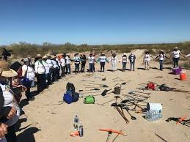
Also the speaker said that organized crime and cartels need the state to survive. This is a reality that is more visible today than ever before.
Currently, the ministry in which different churches join efforts and provide pastoral care is with groups searching for disappeared persons.

Slide 19
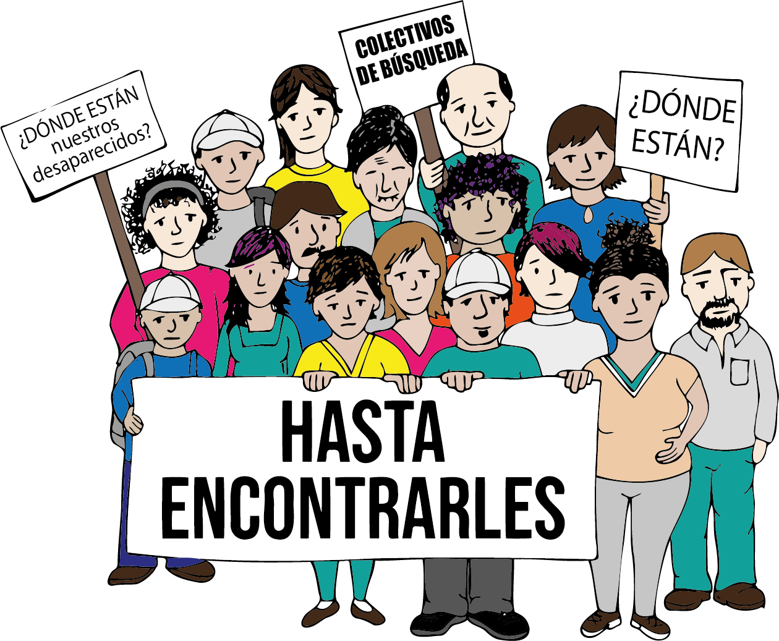
This is a sector largely neglected by the authorities, and there is a great deal of corruption. In other words, support doesn't reach the search groups, which further complicates the government's response.
What the mothers, above all, have done is organize themselves and obtain the necessary tools and supplies. They have followed up on the investigation files, and some mothers who have found the remains of their children, remain in the field, helping other mothers.
.

Slide 20
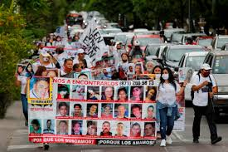
The greatest lesson learned from these groups is their capacity and willpower to move forward, to go against the current, against the authorities, against organized crime, against the harsh weather, against the sadness and despair of having a missing child, and to move forward with their faith and hope firmly in place.

Slide 21
Where is peace in the middle of all of this suffering and desolation?
Peace is the sign that these groups of organized people searching for their belovers make visible.
How?
Waking up each day with the hope of find them, walking side by side, listening to life stories and not re-victimizing anyone, receiving the strength that comes from God, preserving the dignity of the search, and showing that faith and love are the energy to keep going.

Slide 22
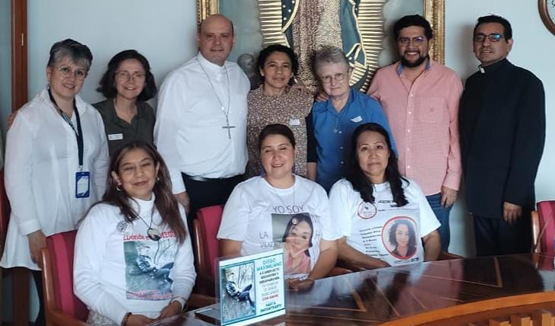
As a church, we have a responsibility and a commitment: to be present in the needs of the people; to listen with compassion and without prejudice; to reconcile and heal the old wounds of indifference and silence, of human exploitation and the exploitation of natural resources.

Slide 23
The desire, the prayer for peace…
If it remains only in human effort, will not be enough; we need goodwill to achieve peace in the world.

Slide 24
The peace of God, which passes all understanding, keep your hearts and minds in the knowledge and love of God, and of his Son Jesus Christ our Lord. Amen.

